Slide 1
Standard User – Approve a Contract
February, 2013

Slide 2

Learning Objectives
Upon completion of this course you will be able to:
View the Approval Task
Reassign an Approval Task to another Individual
Open the Contract and Review (or Edit) the Language and Terms
Enter Comments about the Approval
Approve the Contract
Alternately, Approve a Contract from the My Tasks Portlet

Slide 3
Approval Process Overview
When a contract is sent for approval, the contract language is locked and cannot be changed during the approval process.
The approval task is “accept/reject”.
The approver can respond with “accept” or “reject” but cannot make changes to the contract as part of the approval task.
And, the author cannot make changes if the contract is out for approval.
Note: If the contract is changed after approvals are complete, it will need to go through the approval process again (except in certain unusual and not recommended configurations).

Slide 4
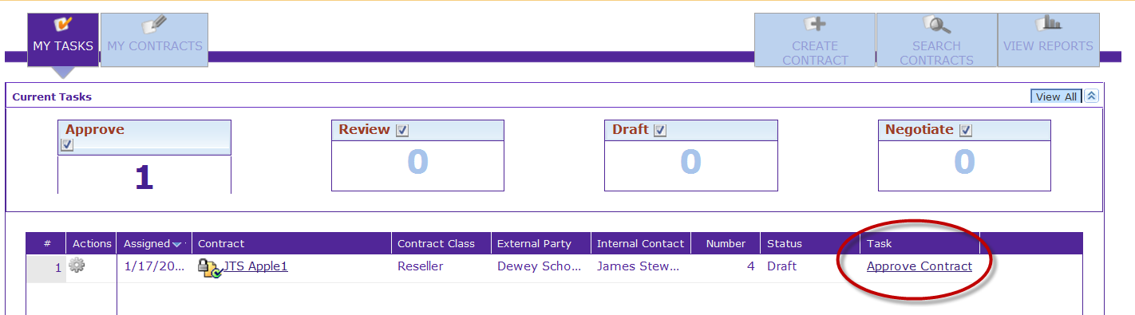
View the Approvals Task
When a contract is sent to you for approval, the Approve Contract task is added to the My Tasks portlet.
To view the description of this task, click the Approve Contract task hyperlink to view the Approval Task details.
The Task Properties dialog box is displayed.

Slide 5
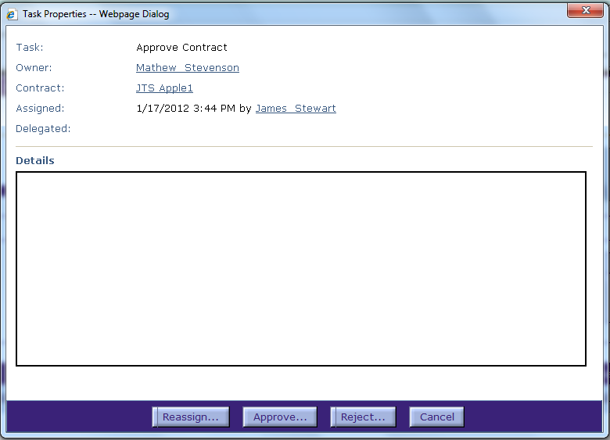
Task Properties Dialog Box
The Task Properties dialog box displays the information about this task request, and gives three ways to proceed. We will talk about Approve and Reject later.
Click the Reassign button; the Reassign Task dialog box is displayed.

Slide 6
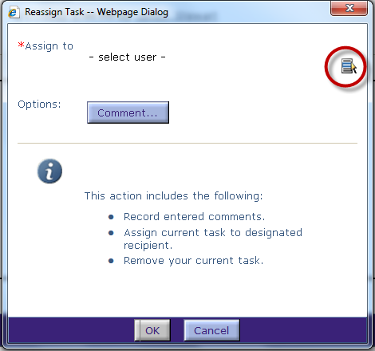
Reassign Task
Click the Select icon to select the user.
The Select Individual dialog box is displayed.

Slide 7
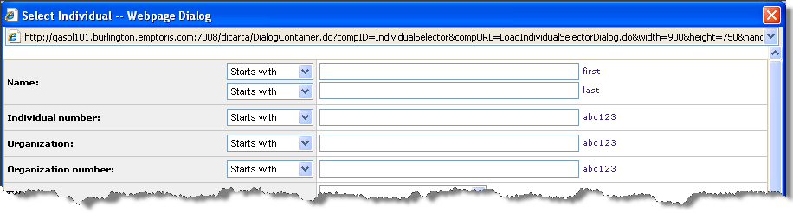
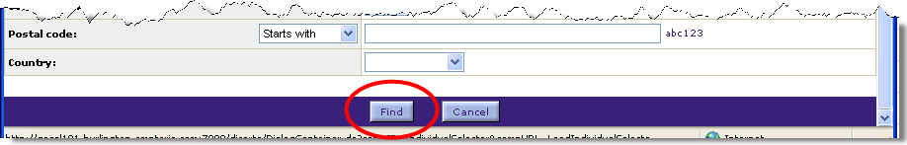
Select Individual
Enter a Name or Partial name (use the drop down list to select “Contains”).
Click the Find button. The users matching your criteria are displayed.

Slide 8
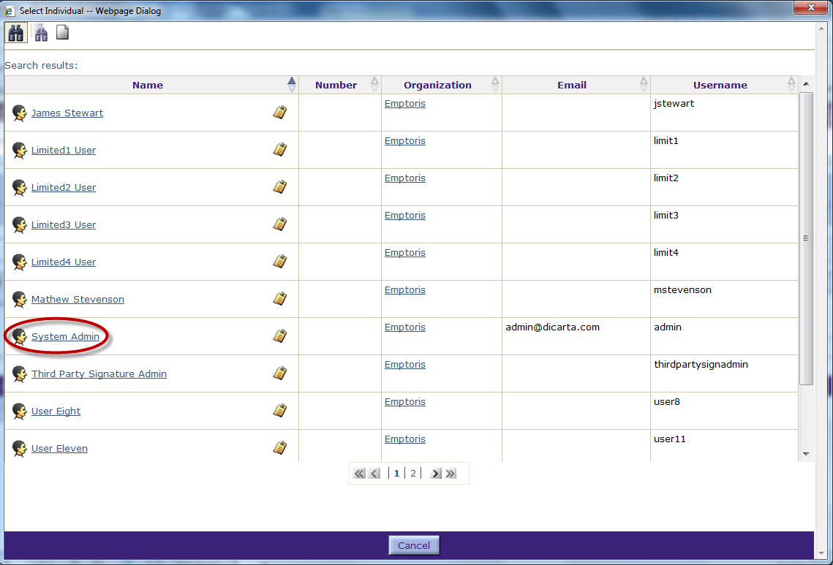
Select Individual, cont.
Use the page number or chevron arrow buttons to navigate to the page with the user name.
Click the Name hyperlink to select the user.

Slide 9
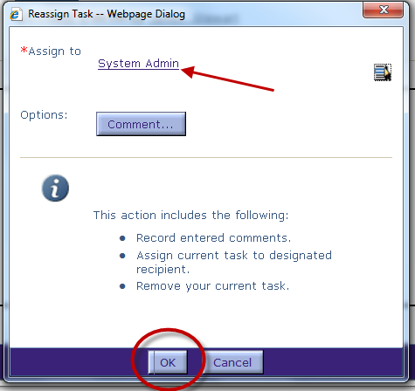
Select Individual, cont.
The name is added to the Reassign Task dialog box.
Click the Comment button to include a comment as to why the task was reassigned.
Click OK when done.

Slide 10
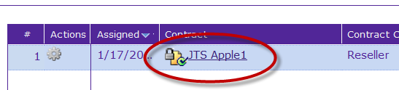
Open the Contract
We will now show how to approve the contract.
One way to begin, on the Home page in My Tasks, is by clicking the contract name hyperlink to open the contract for approval.
The Contract is displayed in the Contract Editor.

Slide 11
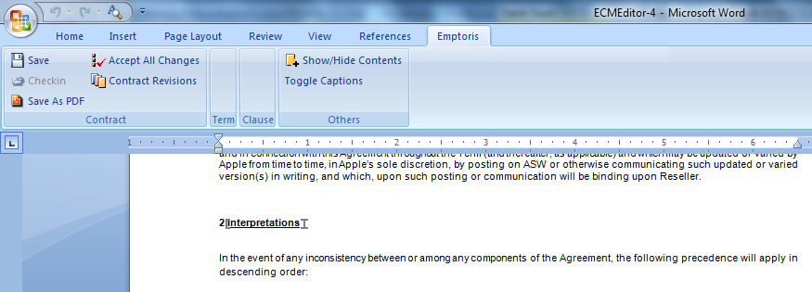
Contract Editor – Review the Contract
On the Contract Editor page, click the Open icon.
  This opens the contract with the Emptoris Word Editor.
You may or may not have permission to make changes as needed prior to approval, based on your role and permissions.
Review the Language and Terms of the Contract.
Click File > Exit to close the contract and return to the Language tab.

Slide 12

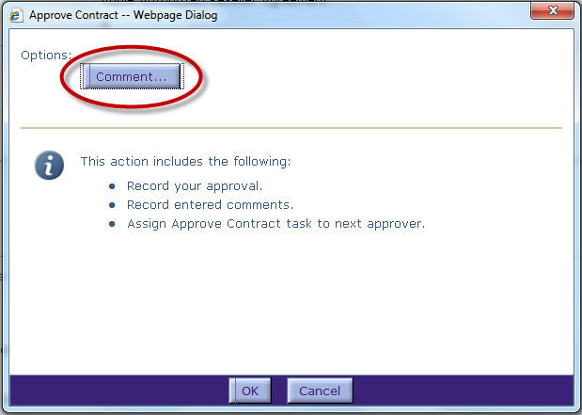
Approve the Contract
From any tab of the Contract Editor, click the Approve Contract icon to approve the language and terms for this contract.
Note: Alternatively, you can click the Reject Contract icon located immediately to the right of the Accept Contract icon.
The Approve Contract dialog
box is displayed.
To enter a comment about
the approval, click the
Comment… button.

Slide 13
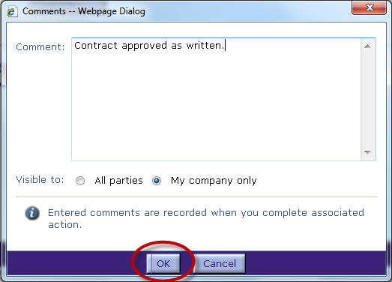
Enter a Comment
Enter a Comment about the approval task.
Select if the Comment will be Visible to ‘All Parties’ or ‘My Company only’.
Click OK when done.
The Approve Contract dialog box is re-displayed.

Slide 14
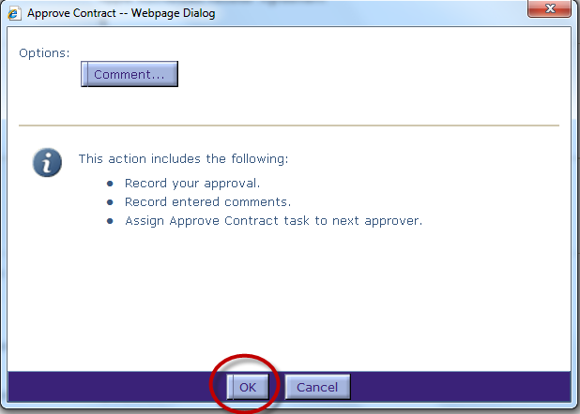
Complete the Approval Task
Click OK to finish the approval process.
The Approve Contract task is removed from the My Tasks portlet.
Depending on the approval chain, a notification may be sent to the persons and/or groups at the next level of the chain.

Slide 15
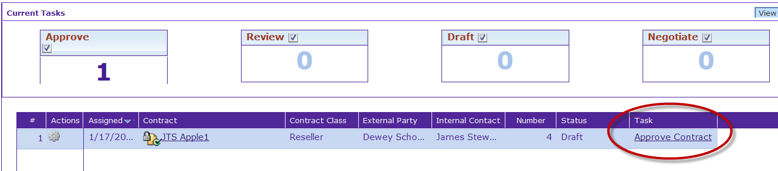
Complete Approval Task from Main Menu
You can also approve a contract directly from the Approve Contract Task on the My Tasks portlet of the Home page.
Click the Approve Contract hyperlink.
The Approve Contract Task properties dialog box is displayed.

Slide 16
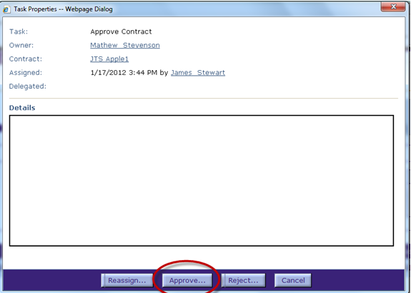
Complete Approval Task from Main Menu
Click the Approve button (or the Reject button, as appropriate).
The Approve Contract dialog box is displayed.

Slide 17
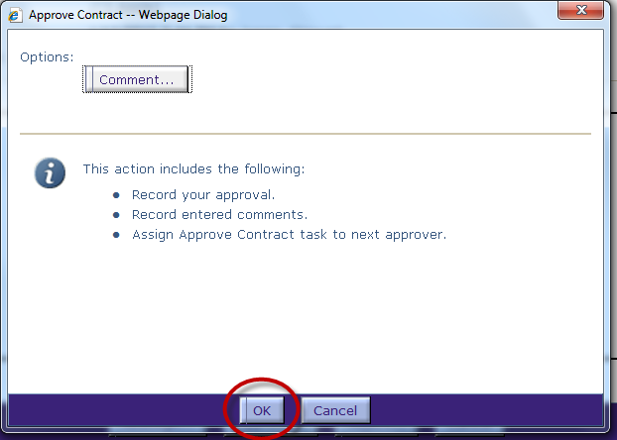
Complete Approval Task from Main Menu
Enter a comment as needed (as described earlier).
The Information section provides details on the actions that will be taken.
Click OK when done. The contract is approved.

Slide 18
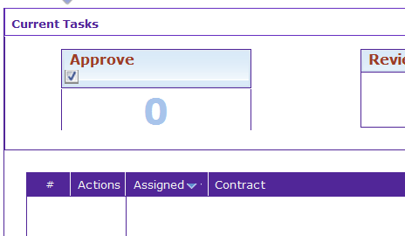
Complete Approval Task from Main Menu
The Approve Contract task is removed from your task list and the counter is decremented.

Slide 19

Questions?

